Slide 1
Java FLP Project
Capgemini MIPL
21th August, 2018

Slide 2
CapStore
(E-Commerce Application)
Notes:
Usar para separador de capitulos . Seria bom ter esta versao em vermelho e verde tb..

Slide 3
CapStore is a web based e-commerce website that allows users to buy or sell products.
CapStore also allows users to sell their products, they need to register on to the website and need to be authorized by the admin of Capstore.
The CapStore Application performs the following
1. Signup, Login or Logout
2. Buy/sell products
3. Give review on products and return them.
4. Merchant- there can be two types of merchants, direct merchant and third party merchant. New merchants can be added or removed by admin. Merchants can add or remove products on CapStore.
5. Items can be added into cart and removed from the cart, after the final submission an invoice will be generated.
6. Customer can pay by different payment options

Slide 4
Feedbacks Common
By
Dhanalakshmi.P
Employee Id-152981

Slide 5
Significance of Module:
After successful delivery of a product, the customer can send feedback to admin.
It can be for direct merchants or for Third party merchants by admin.
Admin will forward the feedbacks sent by the customer to merchants and also redirect their responses to customers.
Scenario:
Admin directing customer feedback to merchant.
Admin redirecting merchant response to customer.
Notes:
Fixar a posicao do titulo – sempre do lado esquerdo.
Sempre que tiver muito texto o coluna deve sempre ser “ narrowed” , se nao fica dificil de ler. Colocar paragrafos no texto.
Linha vertical deve ser mais fina e as pontas NUNCA devem ser arredondadas.

Slide 6
INTERACTIONS WITH OTHER TABLES
MERCHANT
FEEDBACK
Merchant_
Id
Product_Id
Customer_Id
CUSTOMER
PRODUCT
Notes:
Fixar a posicao do titulo – sempre do lado esquerdo.
Sempre que tiver muito texto o coluna deve sempre ser “ narrowed” , se nao fica dificil de ler. Colocar paragrafos no texto.
Linha vertical deve ser mais fina e as pontas NUNCA devem ser arredondadas.

Slide 7
Inventory Table Description
COLUMN NAME | DATATYPE | KEY CONSTRAINTS | DESCRIPTION
Feedback_Id | Integer | Primary Key
Product_Rating | Integer
Cust_Id | Integer | Foreign Key | Fetching from Customer Table
Prod_Id | Integer | Foreign Key | Fetching from Inventory Table
Merch_Id | Integer | Foreign Key | Fetching from Merchant Table
Comment | String
Status | String

Slide 8
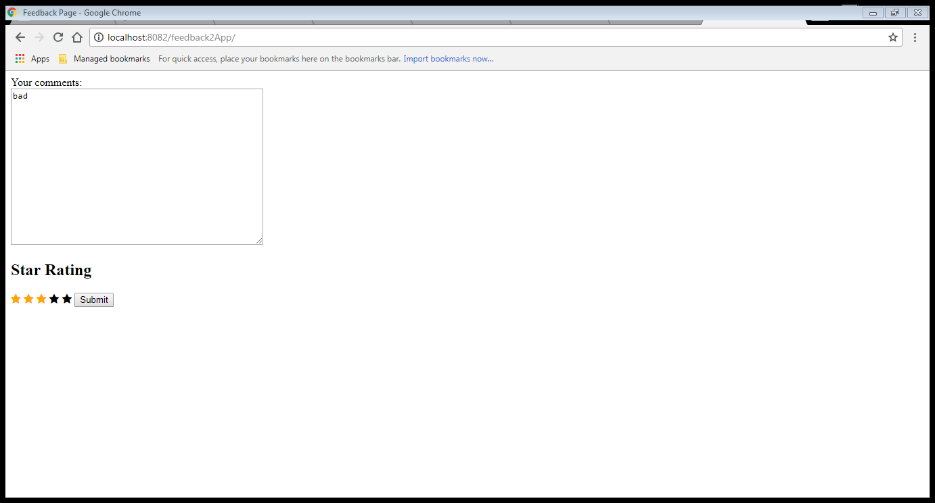
Screenshot of Feedback frontend page

Slide 9
Thank You

